Slide 1
Recurrent Neural Networks
성균관대학교 소프트웨어학과
이 지 형

Slide 2
Sequential Data Modeling
Sequential Data
Most of data are sequential
Speech, Text, Image, …
Deep Learnings for Sequential Data
Convolutional Neural Networks (CNN)
Try to find local features from a sequence
Recurrent Neural Networks: LSTM, GLU
Try to capture the feature of the past

Slide 3
Recurrent Neural Networks
Connections form cycles
x₁
h₁
o₁
x₂
h₂
o₂
…
…
…
x_{m}
h_{k}
o_{n}
c₁
c₂
…
c_{k}

Slide 4
Recurrent Neural Networks
Connections form cycles
x₁
h₁
o₁
x₂
h₂
o₂
…
…
…
x_{m}
h_{k}
o_{n}
c₁
c₂
…
c_{k}

Slide 5
Recurrent Neural Networks
Connections form cycles
x₁
h₁
o₁
x₂
h₂
o₂
…
…
…
x_{m}
h_{k}
o_{n}
c₁
c₂
…
c_{k}

Slide 6
Recurrent Neural Networks
Connections form cycles
x₁
h₁
o₁
x₂
h₂
o₂
…
…
…
x_{m}
h_{k}
o_{n}
c₁
c₂
…
c_{k}

Slide 7
Recurrent Neural Networks
Connections form cycles
x₁
h₁
o₁
x₂
h₂
o₂
…
…
…
x_{m}
h_{k}
o_{n}
c₁
c₂
…
c_{k}

Slide 8
Recurrent Neural Networks
Connections form cycles
x₁
h₁
o₁
x₂
h₂
o₂
…
…
…
x_{m}
h_{k}
o_{n}
c₁
c₂
…
c_{k}

Slide 9
Recurrent Neural Networks
Connections form cycles
x₁
h₁
o₁
x₂
h₂
o₂
…
…
…
x_{m}
h_{k}
o_{n}
c₁
c₂
…
c_{k}

Slide 10
Recurrent Neural Networks
Connections form cycles
x₁
h₁
o₁
x₂
h₂
o₂
…
…
…
x_{m}
h_{k}
o_{n}
c₁
c₂
…
c_{k}

Slide 11
Recurrent Neural Networks
Connections form cycles
x₁
h₁
o₁
x₂
h₂
o₂
…
…
…
x_{m}
h_{k}
o_{n}
c₁
x_{t}
h_{t}
o_{t}
c₂
…
h_{t-1}
c_{k}

Slide 12





Recurrent Neural Networks
Connections form cycles
𝒙_{𝒕}: input at time 𝒕
h_{𝒕}: hidden state at time 𝒕
𝒇: is an activation function
U, V, W: network parameters
RNN shares the same parameters across all time steps
g: activation function for the output layer
o_{t}
$$V$$
$$W$$
$$h_{t}=f\left(Ux_{t}+Wh_{t−1}\right)$$
h_{t-1}
h_{t}
$$\left.o_{t}=g(Vh_{t}\right)$$
$$U$$
x_{t}

Slide 13
Recurrent Neural Networks
Connections form cycles
o_{t}
$$V$$
$$W$$
$$h_{t}=f\left(Ux_{t}+Wh_{t−1}\right)$$
h_{t-1}
h_{t}
$$\left.o_{t}=g(Vh_{t}\right)$$
$$U$$
x_{t}
x₁
x₂
x₃
x₄
x₅

Slide 14
Recurrent Neural Networks
Connections form cycles
o_{t}
$$V$$
$$W$$
$$h_{t}=f\left(Ux_{t}+Wh_{t−1}\right)$$
h_{t-1}
h_{t}
$$\left.o_{t}=g(Vh_{t}\right)$$
$$U$$
x_{t}
o₁
h₁
x₁
x₂
x₃
x₄
x₅

Slide 15
Recurrent Neural Networks
Connections form cycles
o_{t}
$$V$$
$$W$$
$$h_{t}=f\left(Ux_{t}+Wh_{t−1}\right)$$
h_{t-1}
h_{t}
$$\left.o_{t}=g(Vh_{t}\right)$$
$$U$$
x_{t}
o₁
o₂
h₁
h₂
x₁
x₂
x₃
x₄
x₅

Slide 16
Recurrent Neural Networks
Connections form cycles
o_{t}
$$V$$
$$W$$
$$h_{t}=f\left(Ux_{t}+Wh_{t−1}\right)$$
h_{t-1}
h_{t}
$$\left.o_{t}=g(Vh_{t}\right)$$
$$U$$
x_{t}
o₁
o₂
o₃
h₂
h₃
x₁
x₂
x₃
x₄
x₅

Slide 17
Recurrent Neural Networks
Connections form cycles
o_{t}
$$V$$
$$W$$
$$h_{t}=f\left(Ux_{t}+Wh_{t−1}\right)$$
h_{t-1}
h_{t}
$$\left.o_{t}=g(Vh_{t}\right)$$
$$U$$
x_{t}
o₁
o₂
o₃
o₄
h₃
h₄
x₁
x₂
x₃
x₄
x₅

Slide 18
Recurrent Neural Networks
Connections form cycles
o_{t}
$$V$$
$$W$$
$$h_{t}=f\left(Ux_{t}+Wh_{t−1}\right)$$
h_{t-1}
h_{t}
$$\left.o_{t}=g(Vh_{t}\right)$$
$$U$$
x_{t}
o₁
o₂
o₃
o₄
o₅
h₄
h₅
x₁
x₂
x₃
x₄
x₅

Slide 19
Recurrent Neural Networks
Connections form cycles
o_{t}
$$V$$
$$W$$
$$h_{t}=f\left(Ux_{t}+Wh_{t−1}\right)$$
h_{t-1}
h_{t}
$$\left.o_{t}=g(Vh_{t}\right)$$
$$U$$
x_{t}
o₁
o₂
o₃
o₄
o₅
h₁
h₂
h₃
h₄
h₅
x₁
x₂
x₃
x₄
x₅

Slide 20
Recurrent Neural Networks
Long Term Dependency
x₁~x_{t-1} are encoded into h_{t-1}
h_{t-1} has the information on the past
It is a context to process x_{t}
o₅
h₁
h₂
h₃
h₄
h₅
x₁
x₂
x₃
x₄
x₅

Slide 21




Recurrent Neural Networks
Long Term Dependency of Standard RNN
However, it may exponentially decade or grow
Usually it is limited to 10 steps
o₁
o₂
o₃
o₄
o₅
$$W$$
$$W$$
$$W$$
$$W$$
h₁
h₂
h₃
h₄
h₅
x₁
x₂
x₃
x₄
x₅

Slide 22
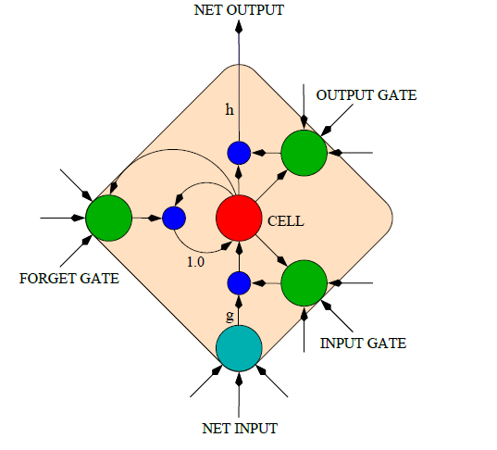
Long Short-Term Memory (LSTM)
Capable of learning long-term dependencies.
LSTM networks introduce a new structure called a memory cell
An LSTM can learn to bridge time intervals in excess of 1000 steps
Gate units that learn to open and close access to the past
Input gate
Forget gate
Output gate
Neuron with a self-recurrent

Slide 23
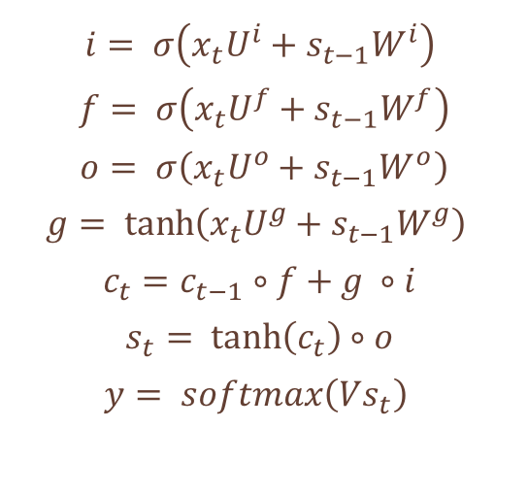
Long Short-Term Memory (LSTM)
Equations
𝒊: input gate to accept the new
𝒇: forget gate to forget the past
𝒐: output gate, how much of the information will be passed to expose to the next time step.
𝒈: self-recurrent which is equal to standard RNN
𝒄_{𝒕}: internal memory
𝒔_{𝒕}: hidden state
𝐲: final output
$$i= σ\left(x_{t}U^{i}+s_{t−1}W^{i}\right)$$
$$f= σ\left(x_{t}U^{f}+s_{t−1}W^{f}\right)$$
$$o= σ\left(x_{t}U^{o}+s_{t−1}W^{o}\right)$$
$$g= \tanh\left(x_{t}U^{g}+s_{t−1}W^{g}\right)$$
$$c_{t}=c_{t−1}∘f+g ∘i$$
$$s_{t}= \tanh\left(c_{t}\right)∘o$$
$$y= softmax\left(Vs_{t}\right)$$

Slide 24



Long Short-Term Memory (LSTM)
o_{t}
$$V$$
How to work
$$W$$
h_{t-1}
h_{t}
$$U$$
x_{t}
h_{t-1}
h_{t}
x_{t}
y_{t}

Slide 25
Long Short-Term Memory (LSTM)
o_{t}
$$V$$
How to work
$$W$$
h_{t-1}
h_{t}
$$U$$
x_{t}
c_{t-1}
c_{t}
h_{t-1}
h_{t}
x_{t}
y_{t}

Slide 26
Long Short-Term Memory (LSTM)
o_{t}
$$V$$
How to work
$$W$$
h_{t-1}
h_{t}
$$U$$
x_{t}
c_{t-1}
+
c_{t}
tanh
g_{t}
h_{t-1}
h_{t}
x_{t}
y_{t}

Slide 27
Long Short-Term Memory (LSTM)
o_{t}
$$V$$
How to work
$$W$$
h_{t-1}
h_{t}
$$U$$
x_{t}
c_{t-1}
*
+
c_{t}
tanh
f_{t}
g_{t}
h_{t-1}
h_{t}
x_{t}
y_{t}

Slide 28
Long Short-Term Memory (LSTM)
o_{t}
$$V$$
How to work
$$W$$
h_{t-1}
h_{t}
$$U$$
x_{t}
c_{t-1}
*
+
c_{t}
tanh
*
f_{t}
g_{t}
i_{t}
h_{t-1}
h_{t}
x_{t}
y_{t}

Slide 29
Long Short-Term Memory (LSTM)
o_{t}
$$V$$
How to work
$$W$$
h_{t-1}
h_{t}
$$U$$
x_{t}
c_{t-1}
*
+
c_{t}
tanh
*
f_{t}
g_{t}
i_{t}
o_{t}
*
h_{t-1}
h_{t}
x_{t}
y_{t}

Slide 30
Long Short-Term Memory (LSTM)
Gradient Flow
Backpropagation from c_{t} to c_{t-1} only elementwise multiplication by f, no matrix multiply by W
c_{t-1}
*
+
c_{t}
tanh
*
f_{t}
g_{t}
i_{t}
o_{t}
*
h_{t-1}
h_{t}
x_{t}
y_{t}

Slide 31
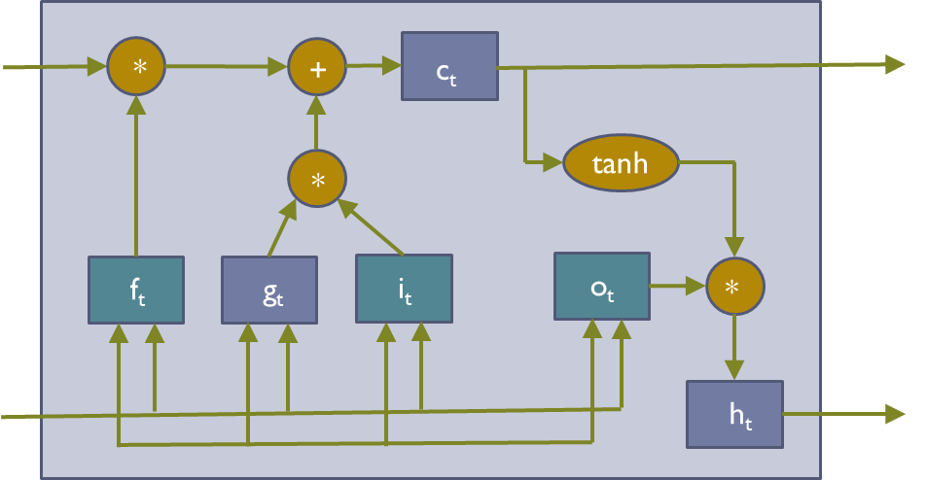
Long Short-Term Memory (LSTM)
Gradient Flow
C₀
C₁
C₂
C₃
h₀
h₁
h₂
h₃

Slide 32
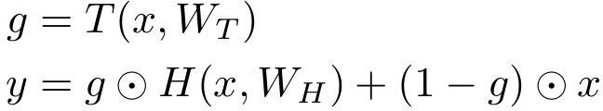
Long Short-Term Memory (LSTM)
Gradient Flow
Uninterrupted Gradient Flow
C₀
C₁
C₂
C₃
h₀
h₁
h₂
h₃
In between:
Highway Networks
Similar to ResNet!
3x3 conv, 128
3x3 conv, 128
3x3 conv, 128
3x3 conv, 128
3x3 conv, 128
3x3 conv, 128 / 2
3x3 conv, 64
3x3 conv, 64
3x3 conv, 64
3x3 conv, 64
3x3 conv, 64
3x3 conv, 64
Pool
7x7 conv, 64 / 2 Input
Softmax FC 1000
Pool
3x3 conv, 64
3x3 conv, 64
3x3 conv, 64
3x3 conv, 64
3x3 conv, 64
3x3 conv, 64
...
Srivastava et al, “Highway Networks”, ICML DL Workshop 2015

Slide 33
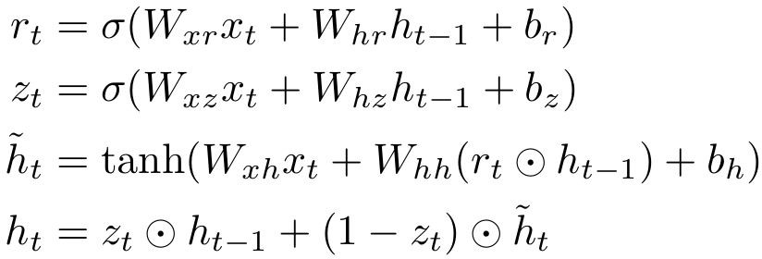
Other Variants
GRU
*
tanh
*
1-z_{t}
r_{t}
z_{t}
*
+
h_{t-1}
h_{t}
x_{t}
y_{t}

Slide 34
Other Variants
o_{t}
$$V$$
GRU
$$W$$
h_{t-1}
h_{t}
$$U$$
x_{t}
tanh
h_{t-1}
h_{t}
x_{t}
y_{t}

Slide 35
Other Variants
o_{t}
$$V$$
GRU
$$W$$
h_{t-1}
h_{t}
$$U$$
x_{t}
tanh
+
h_{t-1}
h_{t}
x_{t}
y_{t}

Slide 36
Other Variants
o_{t}
$$V$$
GRU
$$W$$
h_{t-1}
h_{t}
$$U$$
x_{t}
*
tanh
r_{t}
+
h_{t-1}
h_{t}
x_{t}
y_{t}

Slide 37
Other Variants
o_{t}
$$V$$
GRU
$$W$$
h_{t-1}
h_{t}
$$U$$
x_{t}
*
tanh
*
1-z_{t}
r_{t}
z_{t}
*
+
h_{t-1}
h_{t}
x_{t}
y_{t}

Slide 38
Question and Answer

